Slide 1
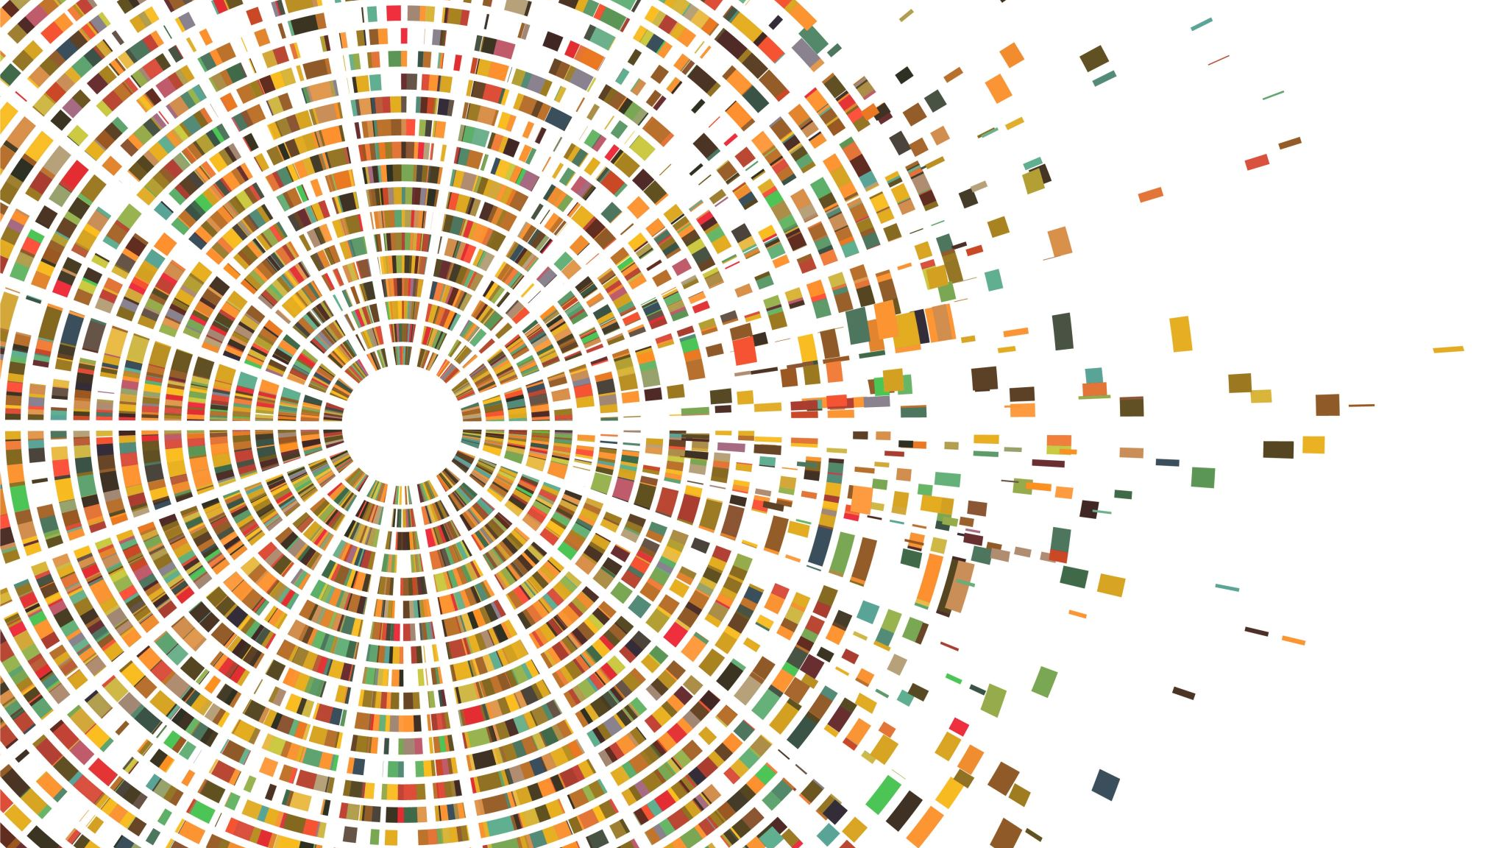
Substrate Subsystems
Off-Chain Worker (OCW)

Slide 2
The Need
Submit external data on-chain via HTTP calls like fetching price & submitting it on-chain.
Run logic every block or after some blocks.

Slide 3
Background
Already existing Off-Chain Application (OCA) that connects to Blockchain’s node RPC in general.
We wanted a system which could have the direct access to runtime extrinsics

Slide 4
Features
Already existing Off-Chain Application (OCA) that connects to Blockchain’s node RPC in general.

Slide 5
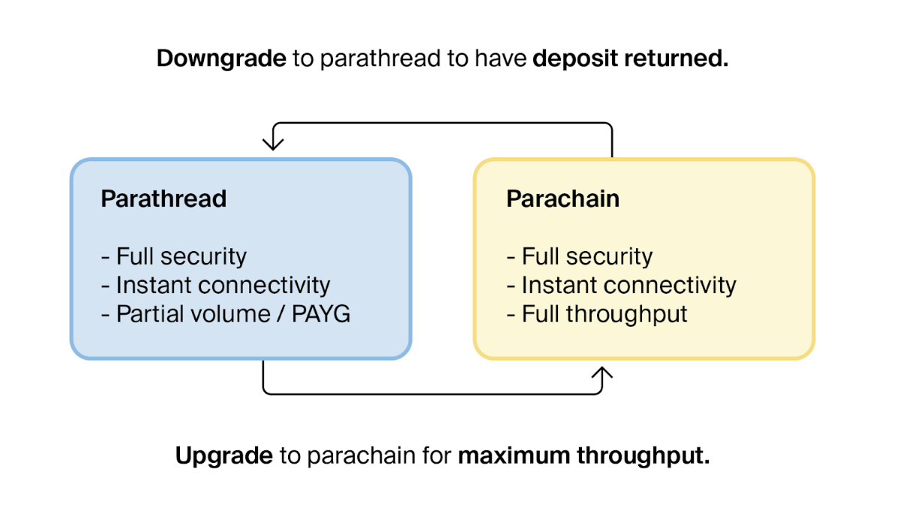
Features

Slide 6
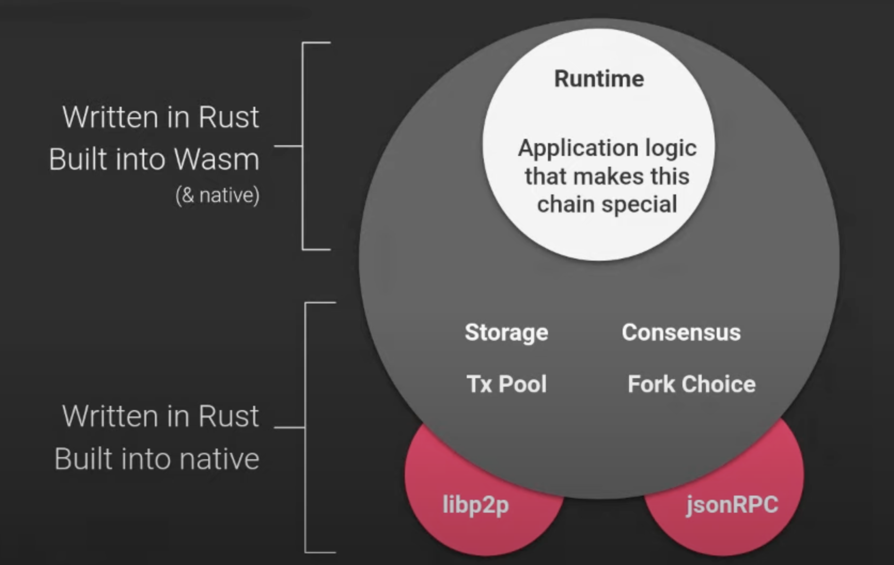
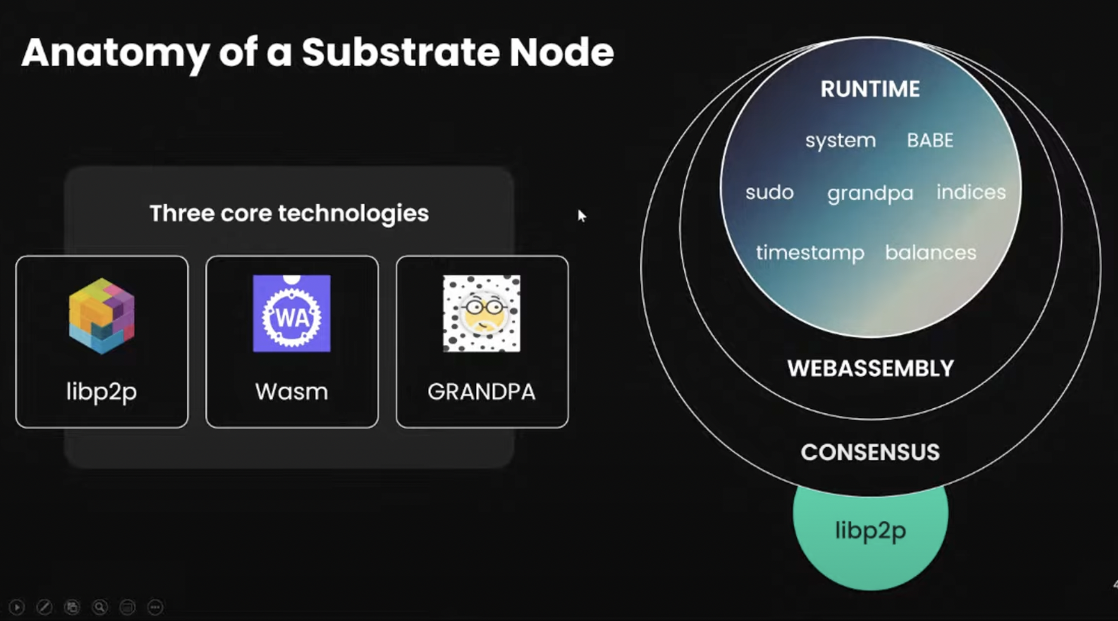
Substrate Node
Important for relaychain validator to carefully architect their technology stack to ensure optimal performance and efficiency.

Slide 7

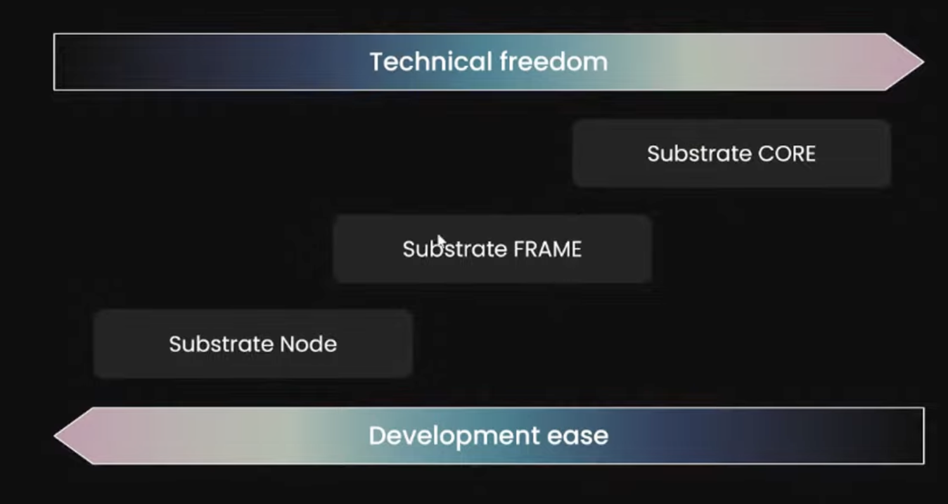
The FRAME
Our Focus
🧑🏻‍💻

Slide 8
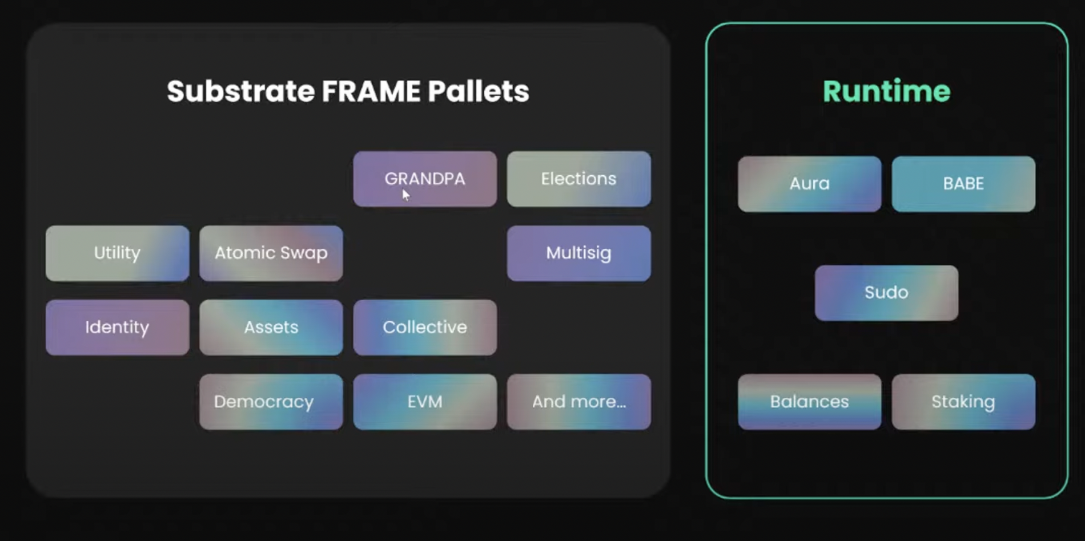

Slide 9
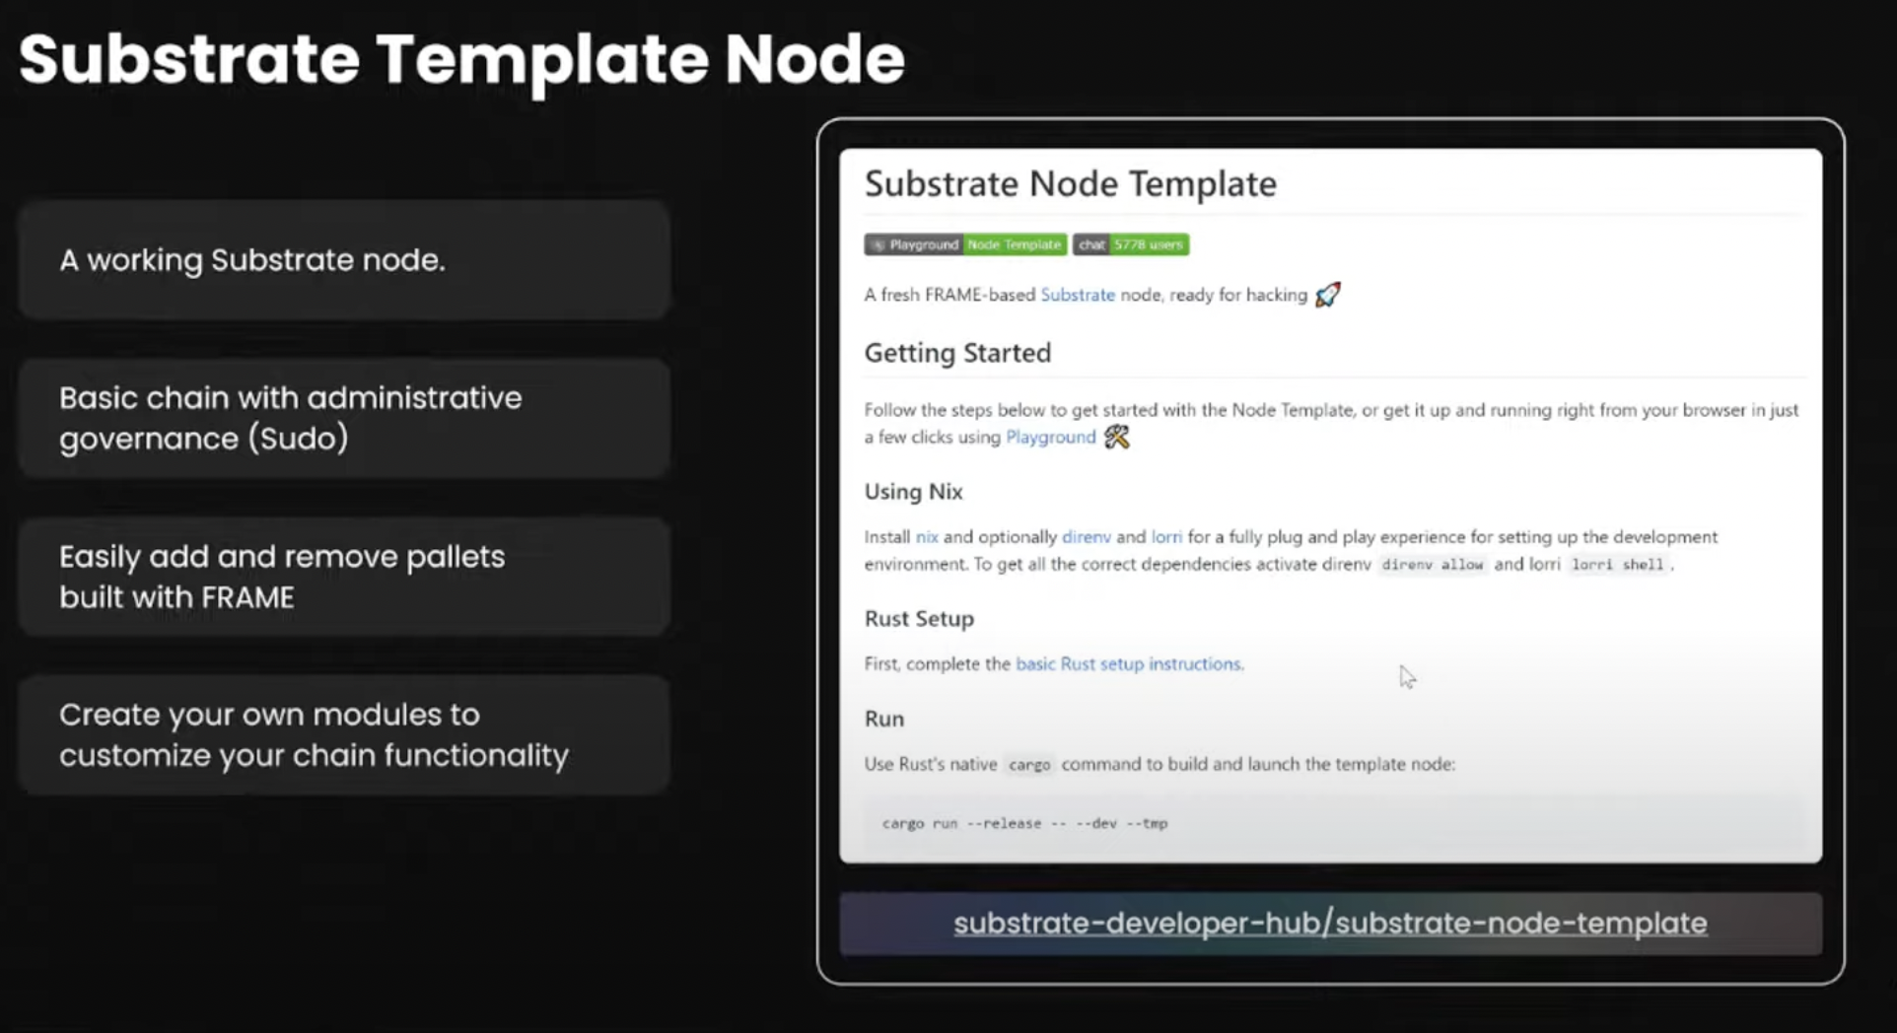
Substrate Node Template
Clone the repo as template & then start adding your own pallet.
Open VSCode

Slide 10

THANKS

